Slide 1



Bank Marketing Data Analysis and Model Evaluation
Berk Apak
Doruk Alan

Slide 2

Business Challenge
1
Predict Term Deposit Subscriptions
2
Target Clients Effectively
3
Reduce Marketing Costs
Accurate predictions would help the bank target potential clients more efficiently and increase campaign success rates.
Focusing efforts on likely subscribers would help the bank reduce unnecessary marketing expenses.
The bank aimed to predict whether clients would subscribe to term deposits based on their demographic and campaign data.

Slide 3
Dataset Overview
Independent Variables
Dependent Variable
Dataset Size
Whether the client subscribed to a term deposit (yes/no).
45,211 instances and 16 attributes.
Client demographics, campaign data, and previous outcomes.

Slide 4

Dataset Overview
Dataset Details: The dataset comprises 45,211 instances and 16 attributes, capturing client demographics, campaign-related information, and previous campaign outcomes.
Independent Variables: Age, Job, Marital status, Education, Default, Balance, Housing loan, Personal loan, Contact type, Day of week, Month, Duration of last contact, Number of contacts performed during this campaign, Days since the client was last contacted from a previous campaign, Outcome of the previous campaign.
Dependent Variable: Whether the client has subscribed to a term deposit (binary: 'yes' or 'no').

Slide 5
Data Preprocessing
Missing Values
Encoding
Filled in using mode for job, education, and contact columns.
Applied one-hot encoding to categorical variables.
Scaling
Balancing
Standardized the dataset using StandardScaler.
Used SMOTE to balance the training set.

Slide 6
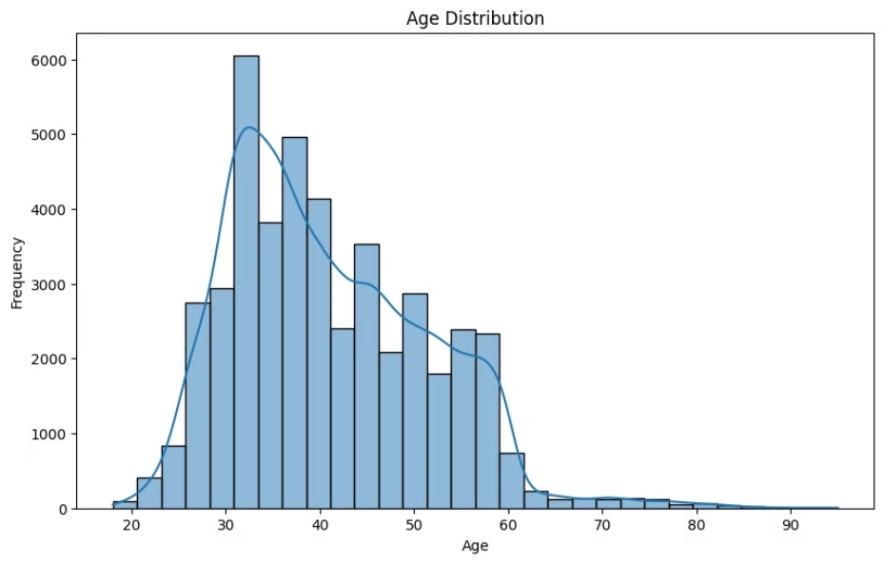
Visualizations After Data preprocessing
Distribution Analysis
Age Distribution

Slide 7
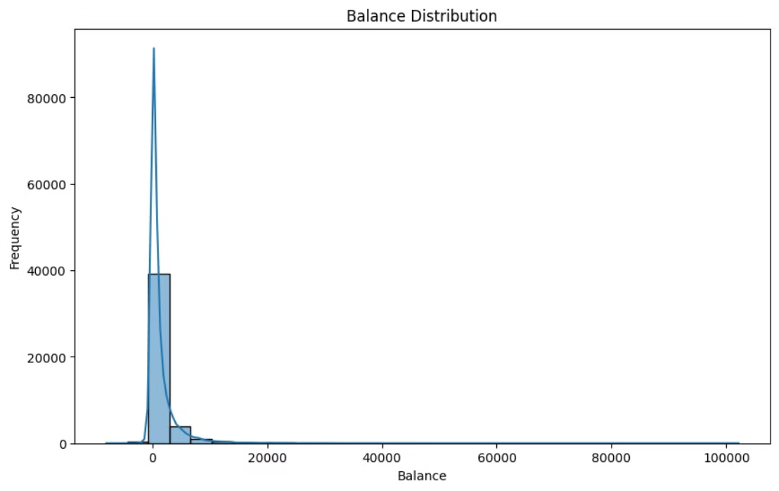
Balance Distribution

Slide 8
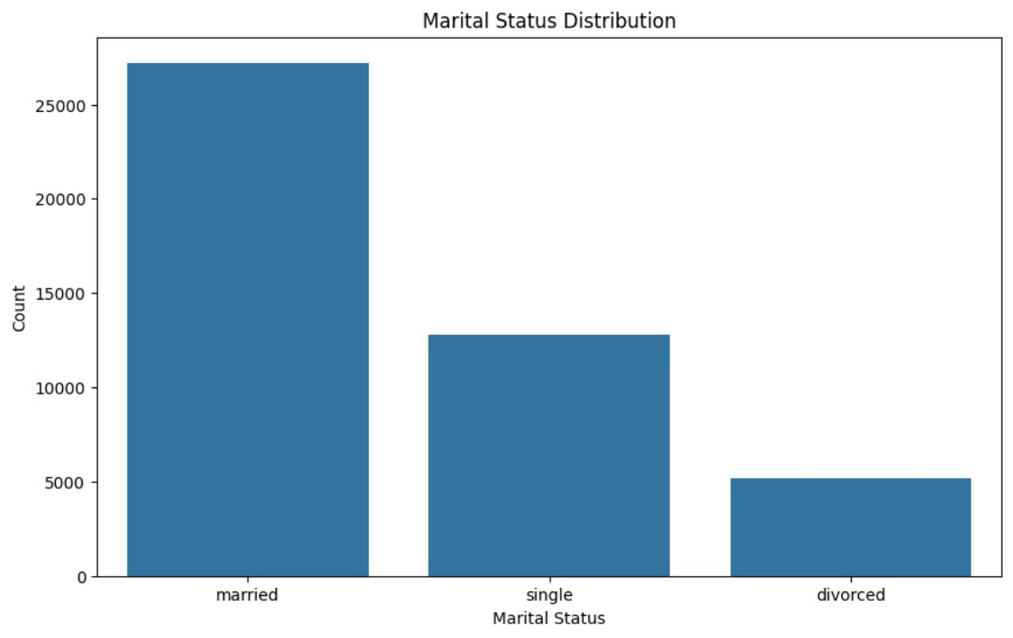
Marital Status Distribution

Slide 9
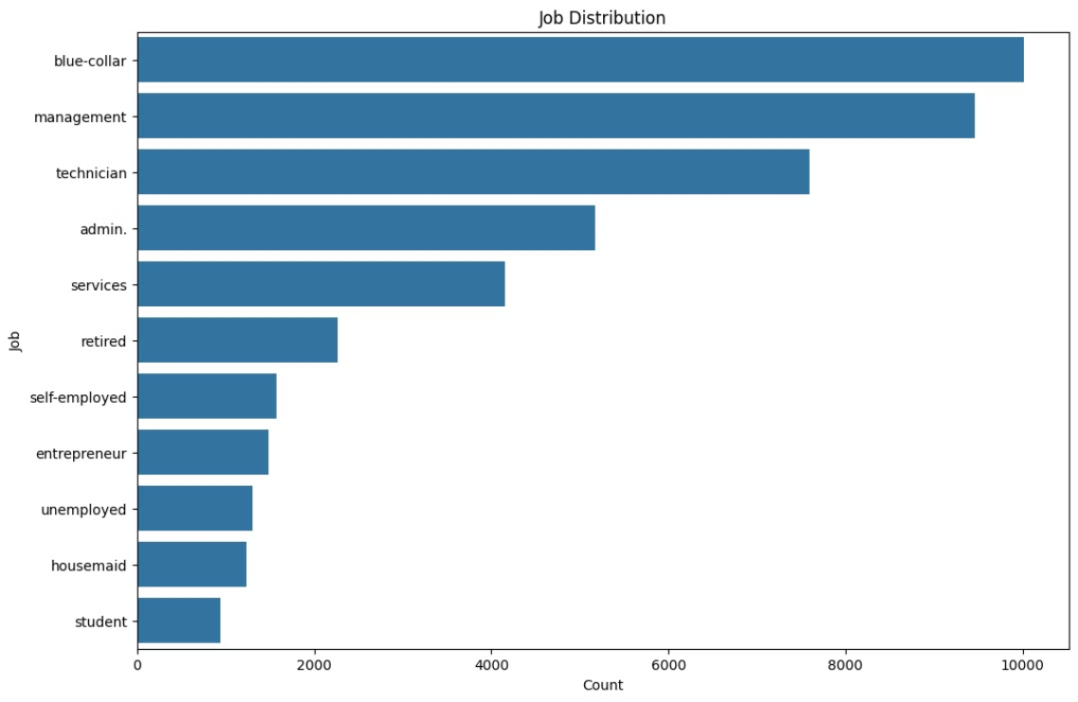
Job Distribution

Slide 10
Model Training and Evaluation
Predictive Analytical Methods Three machine learning models were trained and evaluated:
Logistic Regression
Random Forest Classifier
Support Vector Machine (SVM) with RBF Kernel

Slide 11
Logistic Regression
Performance Metrics:
• Accuracy: 82%
• Precision (no): 0.97
• Recall (no): 0.82
• F1-score (no): 0.89• Precision (yes): 0.38
• Recall (yes): 0.80
• F1-score (yes): 0.52

Slide 12
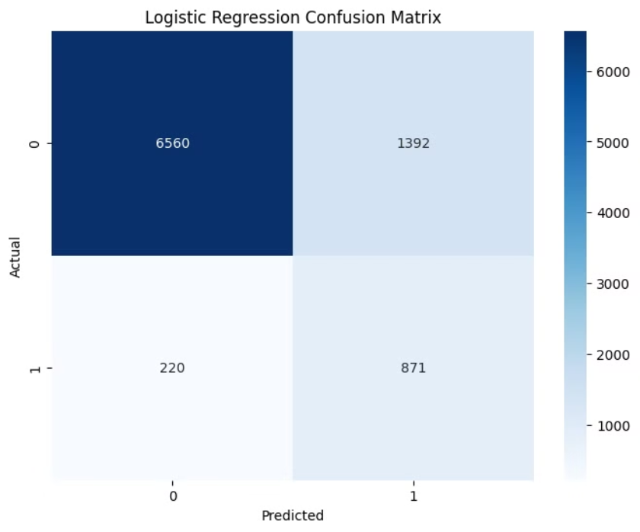
Logistic Regression
Confusion Matrix:

Slide 13
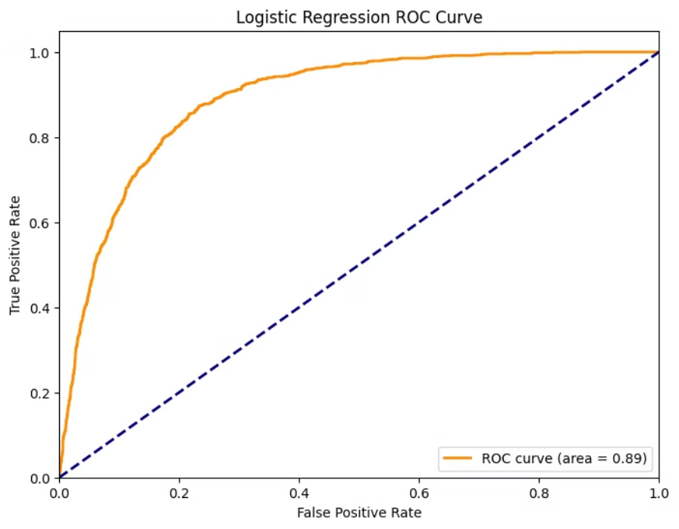
Logistic Regression
ROC Curve

Slide 14
Random Forest Classifier
Performance Metrics:
• Accuracy: 89%
• Precision (no): 0.94
• Recall (no): 0.93
• F1-score (no): 0.94
• Precision (yes): 0.54
• Recall (yes): 0.60
• F1-score (yes): 0.57

Slide 15
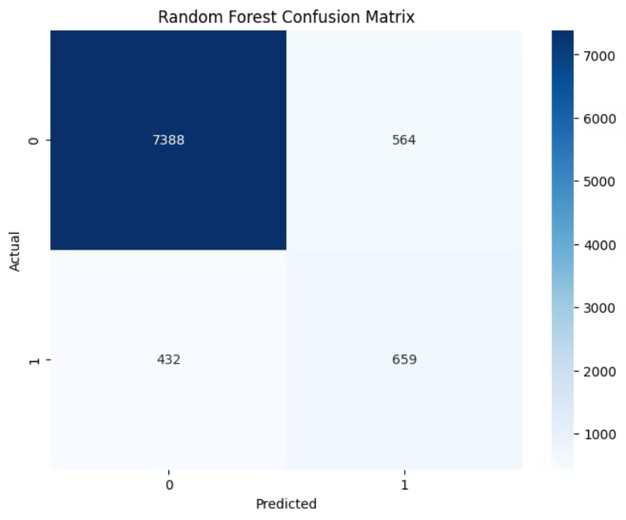
Random Forest Classifier
Confusion Matrix

Slide 16
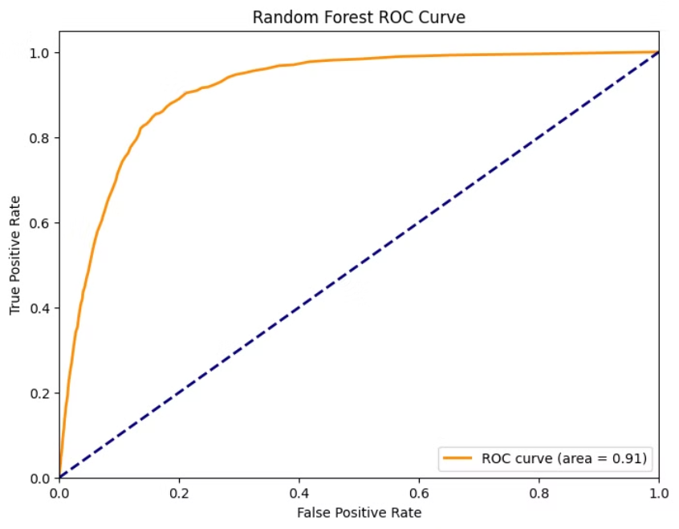
Random Forest Classifier
ROC Curve

Slide 17
SVM (RBF Kernel)
Performance Metrics:
• Accuracy: 84%
• Precision (no): 0.97
• Recall (no): 0.85
• F1-score (no): 0.90
• Precision (yes): 0.42
• Recall (yes): 0.81
• F1-score (yes): 0.55

Slide 18
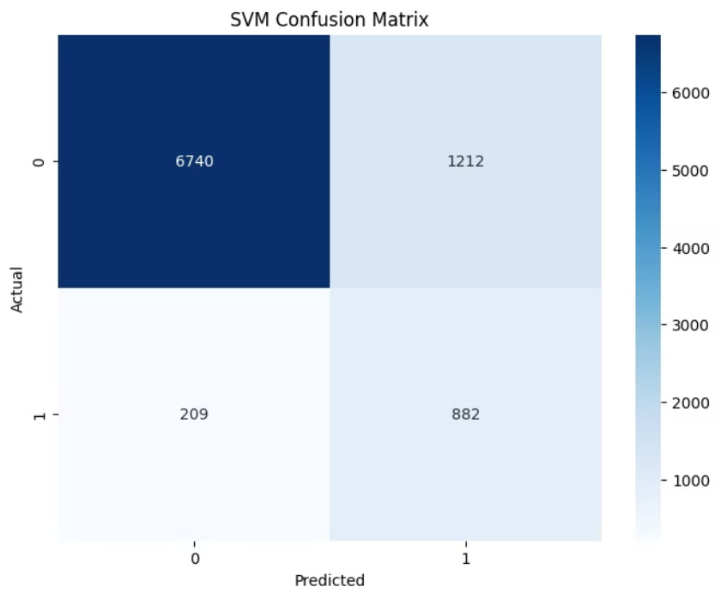
SVM (RBF Kernel)
Confusion Matrix

Slide 19

Model Evaluation
Logistic Regression
SVM (RBF)
Accuracy: 82%, Balanced performance.
Accuracy: 84%, Balanced but slower to train.
1
2
3
Random Forest
Accuracy: 89%, Best overall performance.

Slide 20



Recommendations
Target Clients
Monitor Performance
Refine Strategies
Implement Random Forest model to target clients with higher subscription likelihood.
Continuously monitor model performance and update with new data.
Customize marketing strategies based on client profiles predicted by the model.

Slide 21




Follow-up Plan
Model Deployment
Integrate the Random Forest model into the bank's marketing system.
Performance Monitoring
Continuously evaluate the model's accuracy and update it with new data.
Feedback Loop
Collect feedback on campaign outcomes and refine the model and strategies.

Slide 22
Future Work and Recommendations
Hyperparameter Tuning: Further optimize hyperparameters for the Random Forest and SVM models to potentially improve performance.
Ensemble Methods: Investigate combining multiple models through techniques like stacking or boosting to leverage the strengths of each approach.
Feature Engineering: Explore additional feature engineering to uncover more predictive attributes in the dataset.
Cross-Validation: Implement k-fold cross-validation to ensure the models generalize well and provide more reliable performance metrics.
Ongoing Monitoring: Continuously monitor the models' performance and update them with new data to maintain high accuracy over time.

Slide 23
Conclusion
Predictive Analytics
Significantly improve marketing efficiency and success rate.
Actionable Insights
Comprehensive evaluation and visualization for data-driven decision-making.
Fulfillment
Detailed process from data preprocessing to model evaluation and recommendations.

